Slide 1

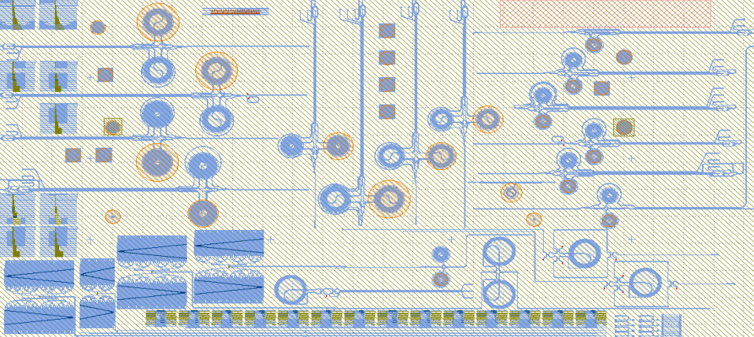
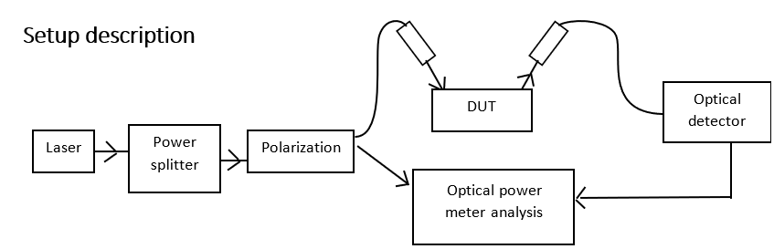
Internship: Fiber-to-Fiber characterization for photonic devices at wafer level
GDS for the manufactured devices (DUTs) at wafer level
Notes:
1- Tunable laser source. (830 – 880 nm)
2- Splitter (99% / 1%).
3- Linear polarizer.
4- Wavelength meter.
5- Sample die.
6- Power detector.
7- Computer.

Slide 2
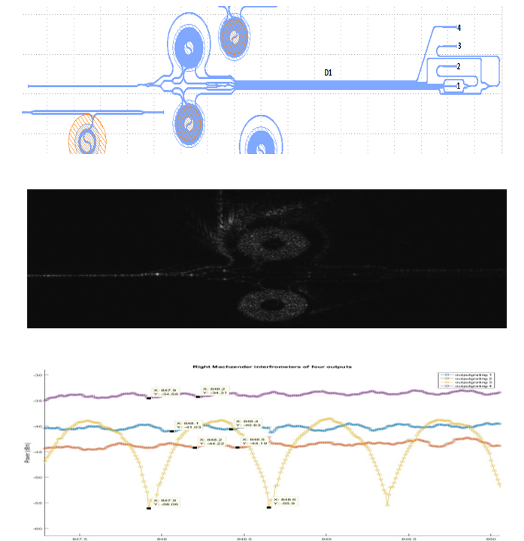
Internship: Fiber-to-Fiber characterization for photonic devices at wafer level
GDS for the manufactured devices (DUTs) at wafer level

